Slide 1

Event Launch

Slide 2


Agenda
Competition Overview
Prizes
Problem Statement
Q&A

Slide 3
Overview
Algothon is an algorithmic trading competition targeted at students who are enrolled in an Australian or New Zealand university. Participants will be given mock historical price data for a variety of instruments and will be tasked with writing a program which trades them.
Important Dates:
Test Dataset Released | Wednesday, 8 July
Webinar + Qualifying Dataset Released | Thursday, 16 July
Qualifying Round Closes | Thursday, 30 July
Finalists Announced + Finalist Dataset Released | Monday, 3 August
Finalist Round Closes | Monday,10 August
Finals | Thursday,13 August

Slide 4
Prizes
1st Place - $5,000pp
2nd Place - $2,500pp
3rd Place - $1,000pp
Top 10 teams will be invited to present their strategies at the 2026 Algothon final in our Sydney Office.

Slide 5

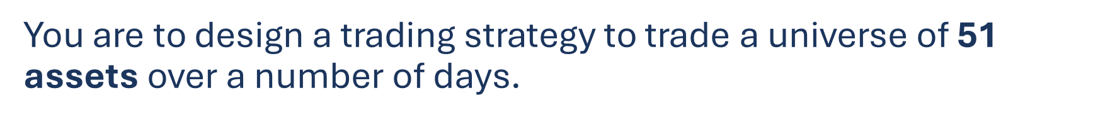
0. ALGO | … | 50. EAFC

Slide 6

 | 0. ALGO | … | 50. EAFC
Day 1 | 100.00 |  | 45.08
Day 2 | 98.49 |  | 44.28
 | ⋮ |  | ⋮

Slide 7
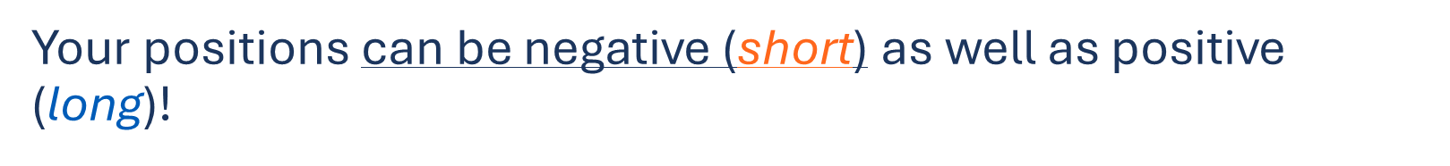

Slide 8
Each of your dollar positions (price x size) in every asset on every day is limited (long or short):
•On the first asset (ALGO), to a max of $100,000.
•On all other assets, to a max of $10,000.

Slide 9
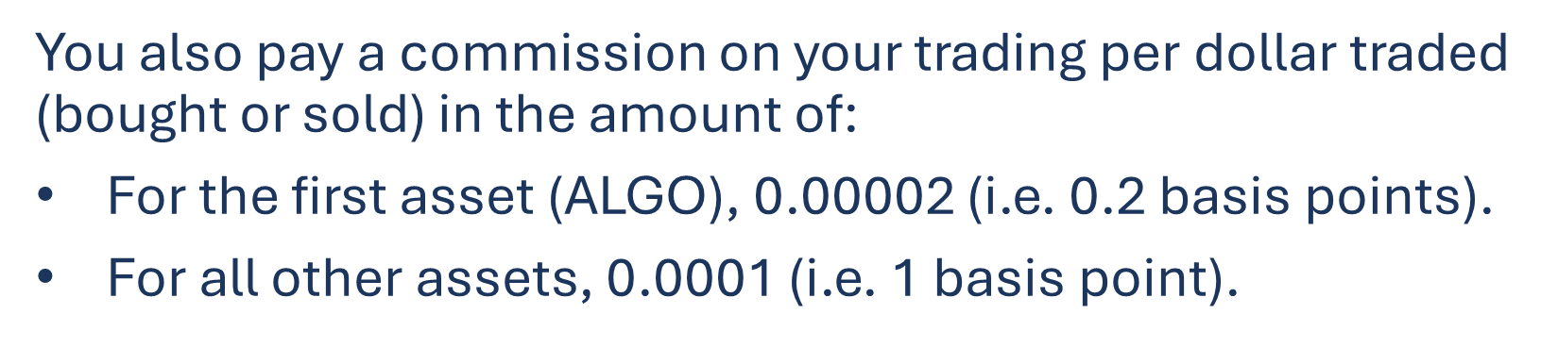

Slide 10
You are scored using the utility function:
PL is the change in portfolio value across days

Slide 11
You are scored using the utility function:
PL is the change in portfolio value across days
μ=Mean⁡(PL)
σ=StdDev⁡(PL)

Slide 12
You are scored using the utility function:
PL is the change in portfolio value across days
μ=Mean⁡(PL)
σ=StdDev⁡(PL)
SR=√250⋅μ/σ

Slide 13
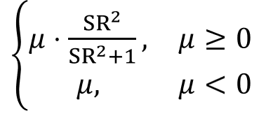
You are scored using the utility function:
PL is the change in portfolio value across days
μ=Mean⁡(PL)
σ=StdDev⁡(PL)
SR=√250⋅μ/σ
Score=

Slide 14
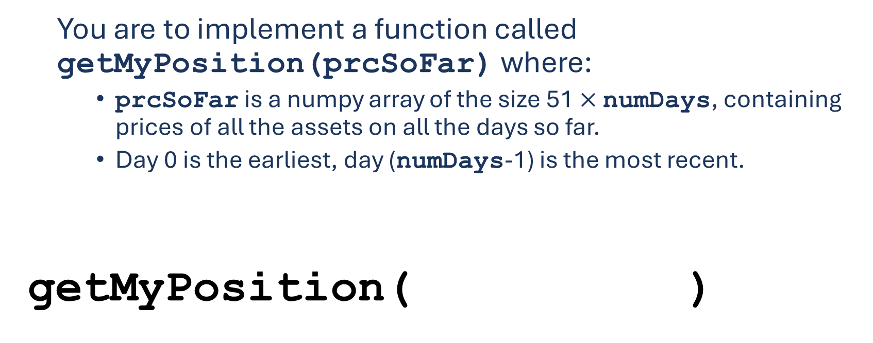

Slide 15
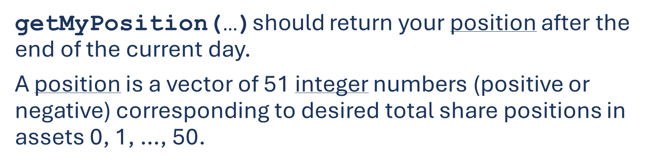


Slide 16



Slide 17
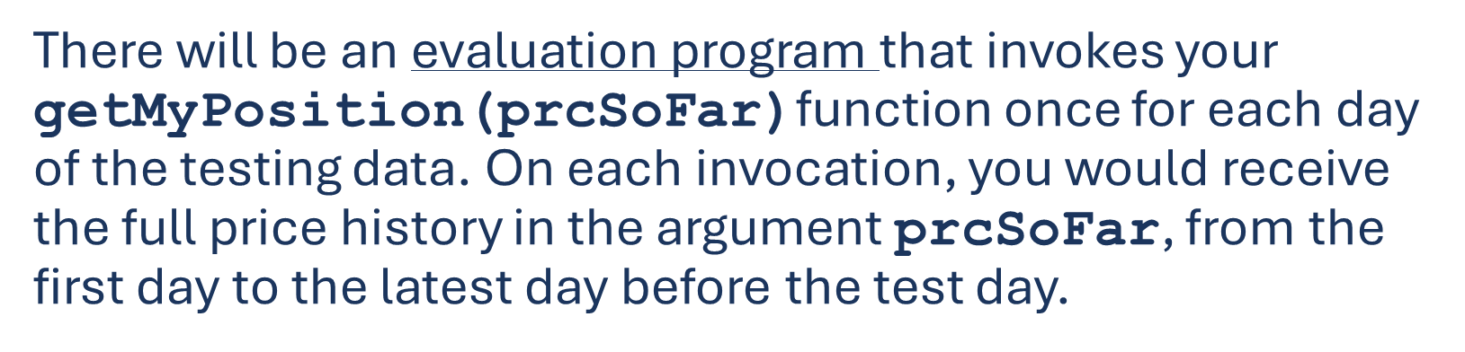


Slide 18

The price data is divided in 4 segments, of 2000 days total
750 days:
Competition kick-off
Live leaderboard

Slide 19


The price data is divided in 4 segments, of 2000 days total
1000 days
750 days:
Competition kick-off
250 days:
General round
Live leaderboard

Slide 20

The price data is divided in 4 segments, of 2000 days total
1500 days
750 days:
Competition kick-off
250 days:
General round
500 days:
Finalist Selection
Live leaderboard

Slide 21
The price data is divided in 4 segments, of 2000 days total
2000 days
750 days:
Competition kick-off
250 days:
General round
500 days:
Finalist Selection
500 days:
Final Round
Live leaderboard

Slide 22

Questions?

